Slide 1




Research in the Center for Radiative Shock Hydrodynamics (CRASH)
R Paul Drake
University of Michigan
Center for Laser
Experimental
Astrophysics Research
Center for Radiative Shock Hydrodynamics
Department of Atmospheric
Oceanic & Space Sciences
Applied Physics Program
Department of Physics
Michigan Institute for Plasma Science and Engineering

Slide 2
Many individuals contribute to the CRASH Team
Co-Principal Investigators
  UM: James P. Holloway, Kenneth G. Powell, Quentin Stout
  TAMU: Marvin L. Adams
Participants
  UM: Eight departments (Math, Stats + six in Engineering)
    Ten instructional faculty
    Eight research faculty
    Twenty graduate students
    Engineers, administrators, undergraduates
  TAMU: Three departments (Nuclear, CompSci, Stats)
    Six instructional faculty
    Eight graduate students
    Technical staff
  Simon Frazer U.: Prof. Derek Bingham and one graduate student

Slide 3
We value our scientific and financial collaborators
Scientific collaborators (partial list):
LLE/Rochester – Knauer, Boehly, Nilson, Froula, Fiskel, others
LLNL – Park, Remington, Glenzer, Fournier, Doeppner, Miles, Ryutov, Smalyuk, Hurricane, others
LANL – Montgomery, Lanier, others
Florida State – Plewa
France – Bouquet, Koenig, Michaut, Loupias, others
Britain -- Lebedev
Texas – Wheeler
Arizona – Arnett, Meakin
Negev – Shvarts, Malamud
Chicago – Abarzhi, others
Financial collaborators:
CRASH:
Predictive Science Academic Alliance Program,
DOE/NNSA/ ASC
(grant DE-FC52-08NA28616)
CLEAR:
Joint HEDLP program
(grant DE-FG52-04NA00064)
National Laser User Facility
(grant DE-FG03–00SF22021)
DTRA grant HDTRA-1-10-0077
Los Alamos Nat. Lab.
Laboratory for Laser Energetics
Past support:
Lawrence Livermore Nat. Lab.
Naval Research Lab.

Slide 4
CRASH is focused on predictive science
What CRASH is about:
  Our goal is to test methods
  that evaluate our predictive capability
  to model complex behavior
    The predictor is a multiphysics computer code
    Radiation hydrodynamic experiments are modeled
  Our approach is to predict the behavior of a more complex system based on measurements of simpler systems
This talk:
  Our radiative shock system and experiments
  The CRASH code
  Predictive science studies

Slide 5
Shocks become radiative when …
Radiative energy flux would exceed incoming material energy flux
where post-shock temperature is proportional to u_{s}².
Setting these fluxes equal gives a threshold velocity of 60 km/s atmospheric-pressure xenon:
σT_{s}⁴ ρ_{o}u_{s}³/2
unshocked
preheated
shocked
Material xenon gas
Density 6.5 mg/cc
Initial shock velocity 200 km/s
Initial ion temperature 2 keV
Typ. radiation temp. 50 eV

Slide 6
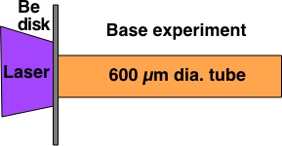
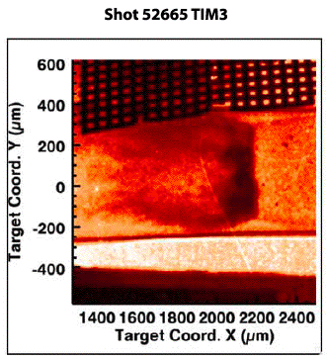
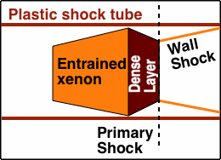
Our simple system is a radiative shock in a circular tube
1 ns, 3.8 kJ laser irradiates Be disk
Drives shock down Xe-filled tube
Radiation ablates wall of tube -> wall shock
Ongoing CRASH experiments chosen first to improve then to test predictive capability
CRASH essential physics: Drake et al HEDP 2011

Slide 7
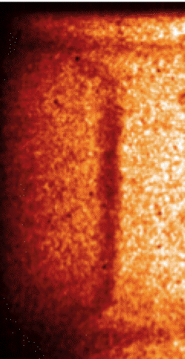
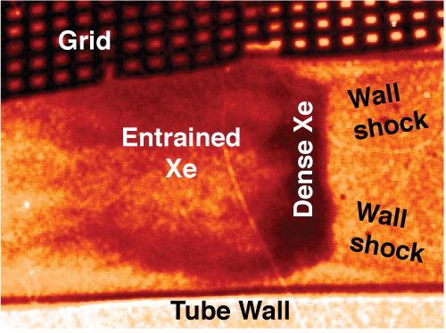
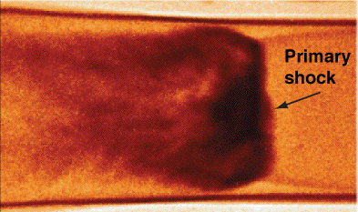
We have used radiography to investigate the lateral structure of these shocks
Bayesian analysis of tilt gives compression ~ 22
  Doss HEDP, A&SS 2010
Shock-shock interactions give local Mach number
  Doss PoP 2009
Shape of entrained flow reveals wave-wave dynamics
  Doss PoP 2011
Thin layer instability; scaling to supernova remnants
  Doss thesis & to be pub.
3.5 ns
13 ns
Radiographs
26 ns
Credit:
Carolyn Kuranz

Slide 8
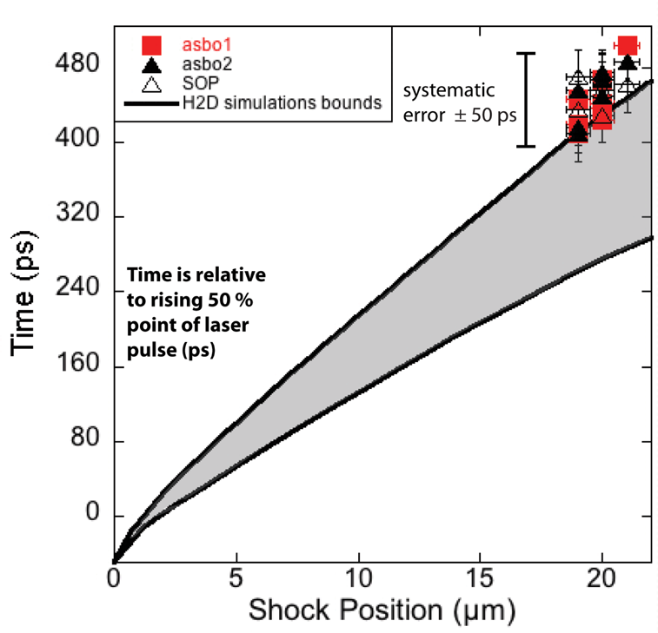
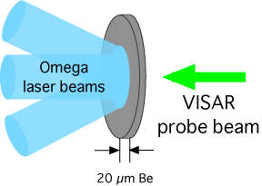
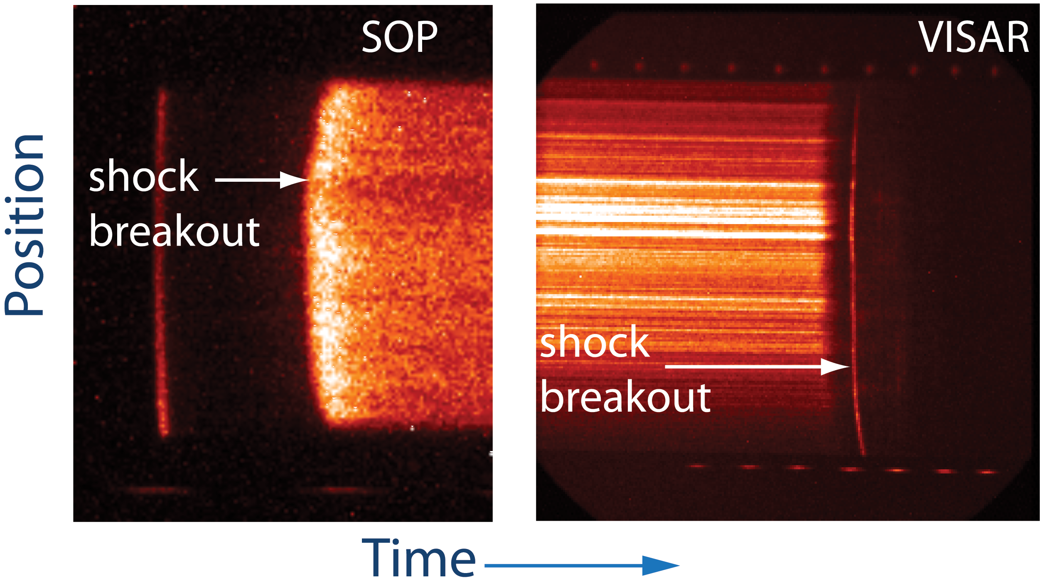
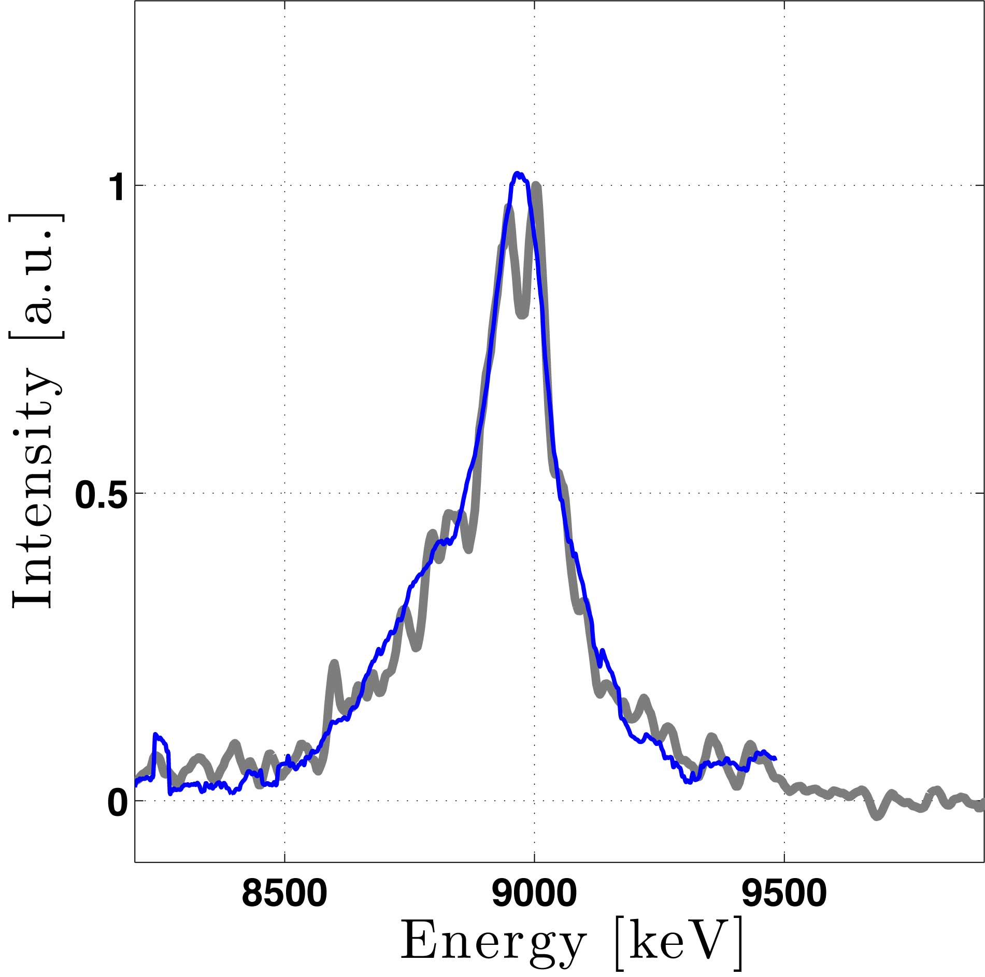
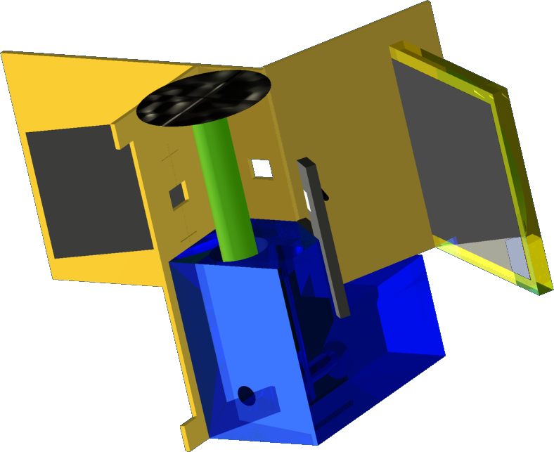
We are also making other measurements
Shock breakout from the Be disk
X-ray Thomson scattering
Papers in prep
  Kuranz et al.
  Stripling et al.
  Visco et al.
  Huntington et al.

Slide 9
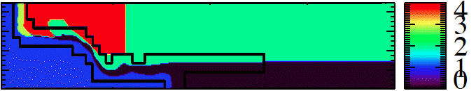
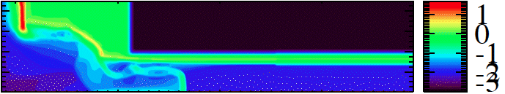
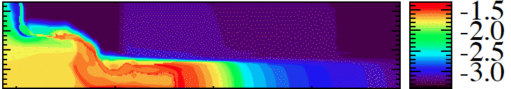
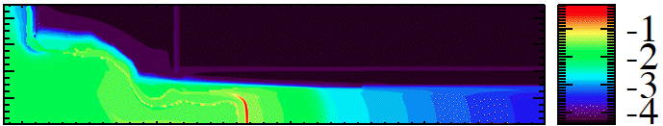
We simulate the experiments using the CRASH code
3D Nozzle to Ellipse @ 13 ns
Dynamic adaptive AMR
Level set interfaces
Self-consistent EOS and opacities or other tables
Multigroup-diffusion radiation transport
Electron physics and flux-limited electron heat conduction
Laser package
Ongoing
  Multigroup preconditioner
  I/O performance upgrade
Material & AMR
Log Density
Log Electron Temperature
Log Ion Temperature
CRASH code: Van der Holst et al, Ap.J.S. 2011

Slide 10
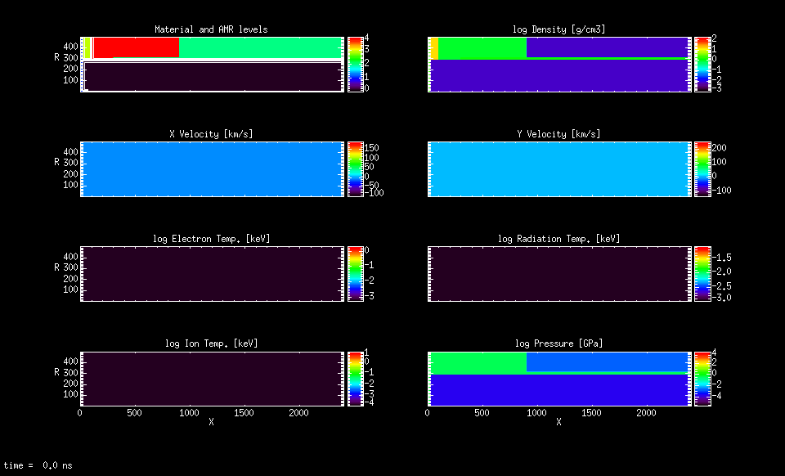
The CRASH 3.0 simulation of the simple experiment reproduces many observed aspects
Materials and refinement
Log Density (g/cc)
Axial velocity (km/s)
Radial velocity (km/s)
Log Elec. Temp. (keV)
Log Rad. Temp. (keV)
Log Ion Temp. (keV)
Log Pressure (Gpa)
All physics, 10 hours on 100 cores

Slide 11
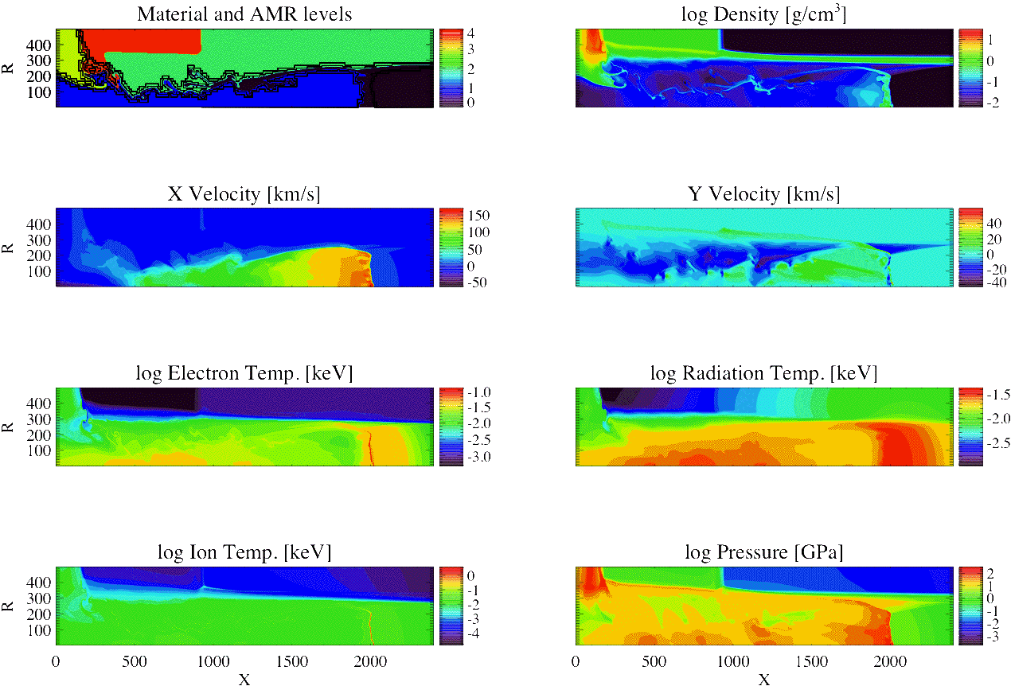
The shock at 13 ns looks much like the data

Slide 12
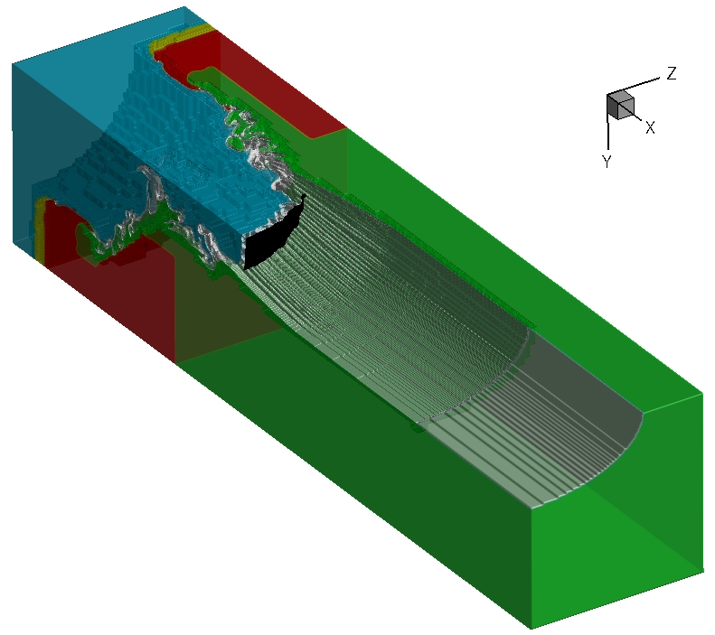
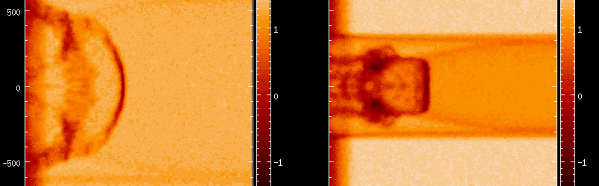
Our complex system drives such a shock into an elliptical tube
Shock at 13ns in Elliptical Tube
This is the system we want to predict
Elliptical simulations:
Van der Holst et al, HEDP
Submitted 2011
First experiments next month Variability study in 2012

Slide 13
Our work in predictive science revolves around inputs and outputs of the code
X_{C}
θ_{C}
θ_{R}
X_{H}
θ_{H}
X_{R}
CRASH
Radiation-Hydrodynamics
Simulation Code
CRASH
Post-Processor
Laser Deposition
Processor
Y_{HP}
Y_{C}
Y_{S}
N_{C}
X - Experiment parameters
θ - Physical Constants
N - Numerical Parameters
Y - Results passed forward and/or analyzed with data by statistical methods
Notes:
This talk’s focus will be primarily on CRASH 3D
Will mention how YHP feeds in and the CRASH postprocessor
There’s a poster on Hyades and how the pre-processor is built from hyades
There’s a poster on the post-processor

Slide 14
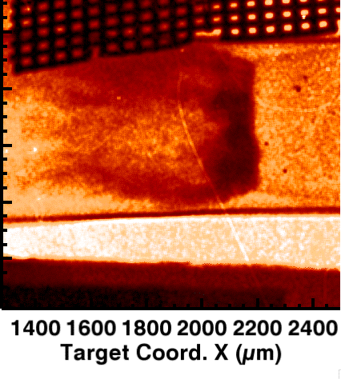
Our inputs and outputs reflect the specifics of our experimental system
Inputs
Outputs (y)
  Integrated Metrics
    Shock location (SL)
    Axial centroid of dense Xe (AC)
    Area of dense Xe (A)
    Radial moments
  Shock breakout time (BOT)
Experimental (x)
  Laser energy
  Be disk thickness
  Xe fill gas pressure
Model parameters (θ)
  Vary with model
  Examples:
    electron flux limiter, laser energy scale factor,
    opacity or group scale factor
Form of model
  e.g. 2D vs 3D

Slide 15
We draw conclusions by comparing run sets in which we vary the inputs with experimental outputs
  Typical multi-D run sets are 128 runs, limited by available cycles
  Run sets are space-filling Latin Hypercube designs
  Current analysis is via Gaussian-process Bayesian modeling
(Sorry for the opaque jargon – no time to explain)

Slide 16
We use a model structure for calibration, validation & uncertainty assessment
Measured in calibration experiments with specific x and unknown theta (few of these)
experimental input
physics or calibration input
Fits code over input space
Replication error
Computed with specific values of x and theta (lots of these)
Models discrepancy between reality and code – speaks to validation
First CRASH application:
Holloway et al RESS 2011
Kennedy & O’Hagan 2000, 2001

Slide 17
Laser energy is an experimental input and is uncertain, especially in advance

Slide 18
Flux limiter is an uncertain model parameter
Need to evaluate probability distribution of such parameters
This can represent calibration or tuning
If the residual discrepancy is small, we get calibration
If not, we get tuning

Slide 19
We combine such models …
In sequence:
  One set of experiments can be used to calibrate parameter probability distributions
  These can be used in another model to predict
Jointly:
  Allows use of cheap and expensive models
  Model-model discrepancy corrects the cheap model to the expensive one
  Use a field-model discrepancy as before
  Jointly fit both and calibrate/tune

Slide 20
The mathematical structure for joint models using two simulation codes is not too complex
Common theta values put in M1 & M2
M1-theta tuned to model M2
Theta values put in model M1 only
Theta values in M2 only
Tuned values of theta

Slide 21
Using this structure we predicted shock breakout time (BOT) using 1D & 2D codes
Tuned 1D
Tuned prediction
This was preparation for jointly using 2D multigroup and 3D gray
Tuned 2D
1D sims
Measurement to be predicted: left out of model fitting
2D sims
Notes:
Leave one out predictions

Slide 22
We are now working to combine complex models and predict our complex experiment
Combine predictions from multiple integral models that are not a strict hierarchy
  Faster running models can help explore the dependence on the input variables
  Jointly use multigroup 2D and Gray 3D
Tune faster running models to slower, better models
  e.g. 2D circular tube to 3D oval tube
Better understand calibration in combined models
Propose best next sets of runs to optimally reduce expected integrated MSE in fitting
Predict year 4/5 experiment

Slide 23

Thanks
http://aoss-research.engin.umich.edu/crash/

