Slide 1
Center for Radiative Shock Hydrodynamics
Fall 2011 Review
PDT and radiation transport
Marvin L. Adams

Slide 2
We continue to develop and PDT and apply it to CRASH problems.
Assessing diffusion model error is a CRASH priority.
  Eric Myra will discuss PDT (Sn) / CRASH (FLD) comparison. [Myra & Hawkins poster].
  We have developed diffusion-error metrics [Hawkins, et al. poster].
Controlling numerical error is a CRASH need.
  Iteration error: preconditioning can be important [Barbu, et al. poster]
  Discretization error, 7 variables: 3 space, 2 directiol, 1 energy, 1 time. [Stripling, et al. poster]
High-dimensional UQ is important for CRASH.
  James Holloway discussed this [Hetzler, et al. poster].
Performance is always important for stressing calculations.
  PDT performance & scaling continue to improve [Hawkins, et al. poster].

Slide 3
Eric Myra and W. Daryl Hawkins have compared PDT transport to CRASH diffusion
Eric will discuss this.
There is a poster [Myra & Hawkins] with more detail.
These comparisons are necessary but not sufficient to assess diffusion model error. There are confounding factors:
  Differences in spatial discretization
  Differences in time centering of opacities and emission source
  Details of discretization-dependent treatment of flux limiters and boundary conditions
This motivates additional analyses.

Slide 4
We explore two diffusion-error metrics that can be generated by transport codes such as PDT.
Last year we introduced the corrective diffusion source:
This source replaces the diffusion-approximate vector flux with the transport vector flux.
The corrective source can be calculated within PDT using consistent discretizations, time centering, etc..
  This removes many “confounding factors.”
Source magnitude relative to other terms in the equation (such as σcE ) relates to diffusion model error.
  [error] = [Operator]⁻¹[corrective source].
  Ignores error in electron temperature and E^{n}.
  Ignores effect of flux limiter.

Slide 5
The second diffusion-error metric involves the Eddington tensor.
Manipulation of the (fully-implicit) transport equation yields:
where:
Examine flow term:
See Hawkins, et al. poster
Notes:
Discussing this took a very long time
Ended this slide at about 11 minutes into talk

Slide 6
Recall CRASH-like test problem, which helps us assess model & discretization errors.
Au
19.3 g/cc
Xe
0.1 g/cc
plastic
1.43 g/cc
.3125 mm
Be
0.008 g/cc
Xe
0.018 g/cc
Xe
0.0059 g/cc
electron energy source
4 mm
Constant energy deposition to electrons at “shock”
Can assess effects of
  discretization in energy, direction, space, and time
  transport vs. diffusion

Slide 7
Eddington-tensor results are illuminating.
Example:
Poster [Hawkins, et al.], with associated movies and viewer-directed interactive graphics, shows detail.
diffusive
ω_{xx}
ω_{xy}
ω_{yy}

Slide 8
We use PDT to study discretization error and resolution needs for CRASH problems.
We are exploring how the solution changes as a function of resolution in space, angular, energy, and time. We focus on energy deposition in plastic wall.
See Stripling, et al. poster

Slide 9
We use PDT to study discretization error and resolution needs for CRASH problems.
Lineouts of deposition rate density help us assess energy/angle differences.
See Stripling, et al. poster
Notes:
This discussion needs to be more nuanced.
No practical rad hydro simulation will resolve the wall deposition.
Group convergence is much more an issue in cold plastic than in warm Xe or Be.
We have shown posters in prior years about analysis of the heated wall resolution issue with CRASH and Hyades in 1D.

Slide 10
We are using PDT to study uncertainties caused by uncertain opacities.
James Holloway discussed this.
A poster [Hetzler, et al.] gives more detail.
Shameless advertisements to encourage poster-viewing:
  This is a foray into physics-based dimension reduction.
  We treat inputs into opacity code (not the opacities) as the uncertain inputs.
    Correlations among opacity values are automatically correct – no need for approximate statistical models.
    Must generate opacity tables for each sampled input point.
  Scale of exercise:
    32-dimensional input space
    32k (Latin hypercube) sample points ➔ 32k sets of opacity tables and 32k rad-transfer calculations (1D)
    Used 32k cores on BG/L

Slide 11
Preconditioners are important in radiative transfer.
In radiative transfer, regions have wide ranges of optical depth.
  In CRASH, the Be and quiescent Xe are thin for much of the time, while the plastic is thick for most of the time.
For transport, the “sweep” preconditioner is effective for optically thin regions. This is why we focus on sweep scaling.
  See poster on PDT performance and scaling.
For transport with sweeps, convergence rate of simple fixed-point (“Richardson”) iteration is governed by
For thick regions and/or long Δt this → 1 ➔ slow convergence.

Slide 12
We have developed and implemented a diffusion preconditioner.
Implemented as additive correction to the sweep result:
Grey opacities are averaged per Larsen’s GTA method.

Slide 13
The grey diffusion preconditioner reduces iteration count and iteration error.
Recall that for ill-conditioned system:
  iteration error can be >> residual
Rad-transfer problems can be so ill-conditioned (unless time steps are severely restricted) that it is difficult to estimate or control iteration error.
Example results from Myra/Hawkins test problem (3.7):
  unaccelerated: 414,454 transport sweeps to reach 0.05 ns
  accelerated: 9,925 transport sweeps to reach 1 ns
Picture not completely rosy yet. Need preconditioner for grey diffusion equation.
See poster [Barbu et al.] for details.

Slide 14
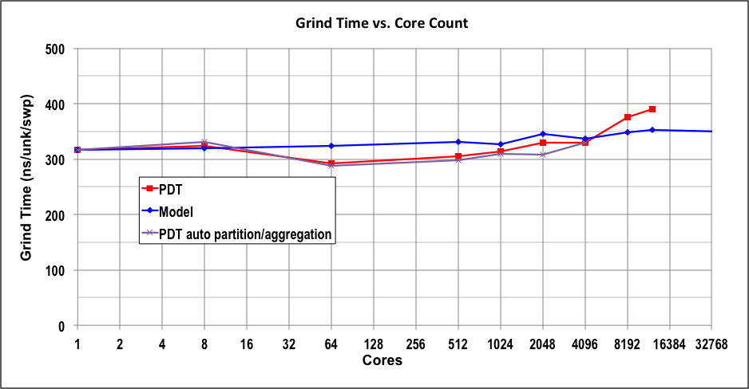
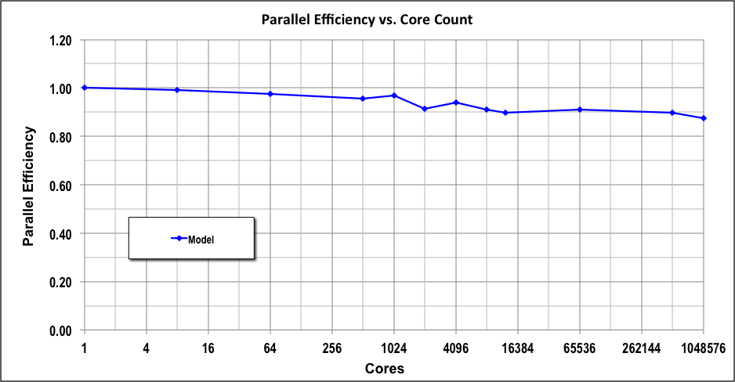
We continue to improve
PDT’s performance and scaling.
Without good performance and scaling, high-resolution transport solutions are not practical.
  PDT continues to improve
  Recent: automated optimal sweep parameters
  Pipe-fill is not show-stopper to O(10⁶) cores …
Poster [Hawkins, et al.] has details.
model

Slide 15
We continue to develop and PDT and apply it to CRASH problems.
Assessing diffusion model error is a CRASH priority.
  Eric Myra will discuss PDT (Sn) / CRASH (FLD) comparison. [Myra & Hawkins poster].
  We have developed diffusion-error metrics [Hawkins, et al. poster].
Controlling numerical error is a CRASH need.
  Iteration error: preconditioning can be important [Barbu, et al. poster]
  Discretization error, 7 variables: 3 space, 2 directiol, 1 energy, 1 time. [Stripling, et al. poster]
High-dimensional UQ is important for CRASH.
  James Holloway discussed this [Hetzler, et al. poster].
Performance is always important for stressing calculations.
  PDT performance & scaling continue to improve [Hawkins, et al. poster].

